Slide 1
PRE-MAP 2026–2027
Can Tidal Forces Lead to Habitability on Close-in Exoplanets?
Héctor E. Delgado Díaz
Ph.D., Astronomy & Astrobiology
University of Washington
Notes:
Hi, I'm Héctor. I did my PhD here in Astronomy and Astrobiology, and my research asks whether planets around other stars could have climates where life like ours could exist. This year I'm looking for two students to work with me on one question: can tides make a planet habitable?

Slide 2
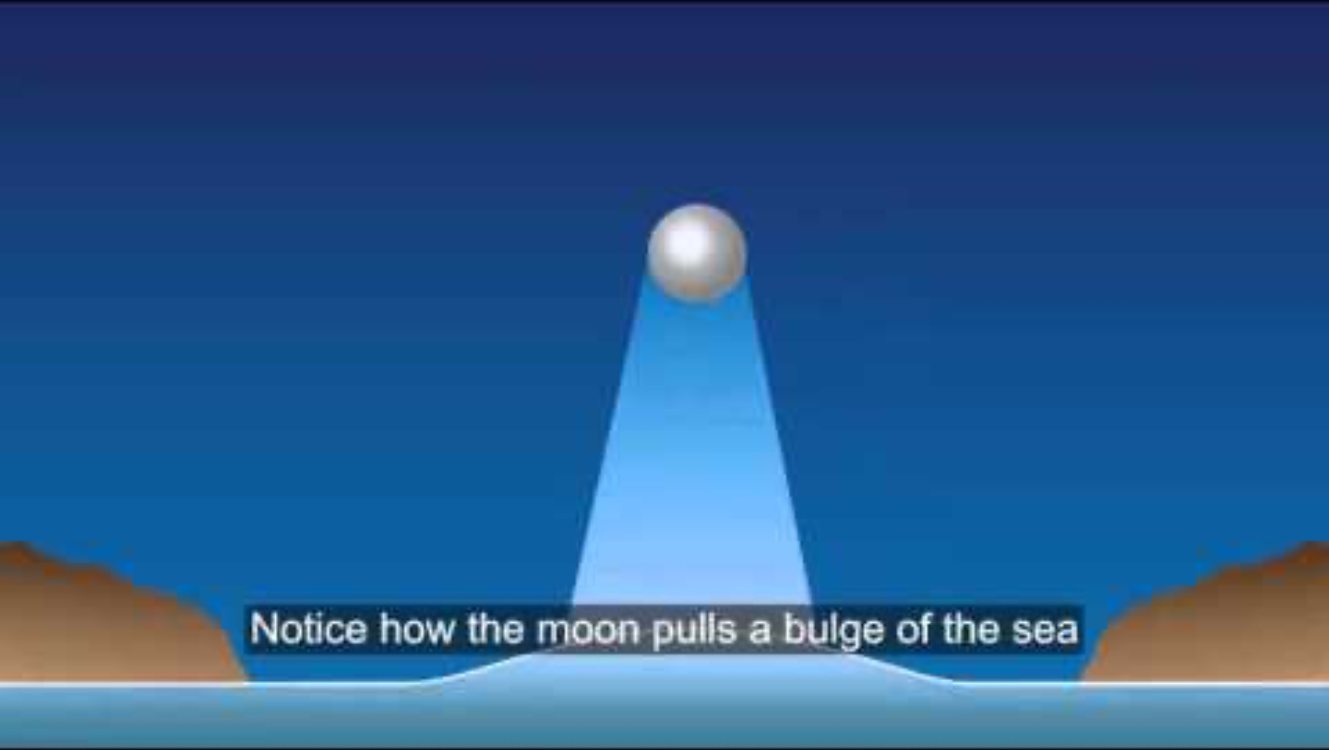

Slide 3
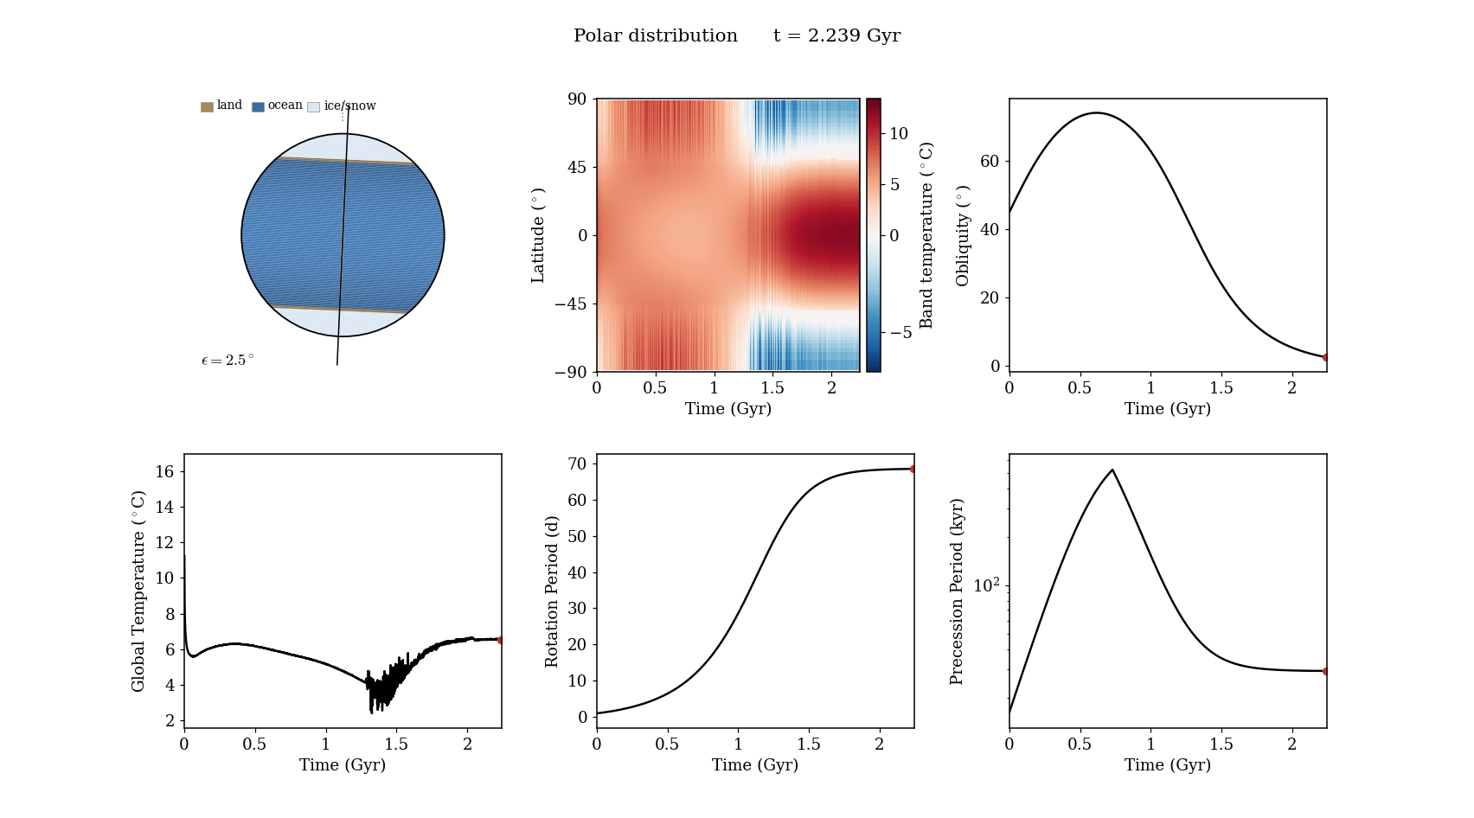
Tides Reshape a Planet’s Climate
Planet Starts Warm
SMALL, COOL STARS
M stars are dimmer than the Sun, so a warm planet must orbit close in.
CLOSE ORBITS FEEL TIDES
The star’s pull slows the planet’s spin and tips its axis, which changes the seasons.
ORIGINAL RESULTS
Adding tides left 61 of 87 temperate climates (that had not tides) frozen or overheated. Tides did not convert extreme climates into temperate.
Could tides do the opposite?
Turn a frozen or overheated planet into a habitable one
One simulated planet over 2.2 billion years: tides tip its axis from 45° past 70° and back to nearly upright, and slow its spin from one turn a day to about one every ten weeks. Ice caps grow at both poles.
Notes:
Small, cool M stars are the most common stars in our galaxy. Because they are dim, a planet has to orbit close in to be warm, and that close, the star's gravity raises tides on the planet. Those tides slow the planet's spin and change the tilt of its axis, and that changes its seasons and its climate. [Play video] This is one of my simulations. Top left is the planet with its land and ice. Next to it is the temperature at each latitude through time, and the tilt of the axis. Watch the tilt go up past 70 degrees and then come back down to almost zero, the day get longer, and ice caps form at both poles. In my PhD, tides took habitable climates and made them frozen or too hot: 61 of 87. So tides can take habitability away. Your project asks whether they can also give it.

Slide 4




Software & Skills
SKILLS YOU WILL USE
VPLanet
UNIX command line
open-source code that follows how planets change over billions of years
set up runs and move your files around
Python: numpy and matplotlib
POISE
EQTIDE
read the output and turn it into plots
the climate
the tides
how warm each latitude gets through the year, and where ice grows or melts
how the star’s pull slows the spin and tips the axis
Hyak Klone, UW’s supercomputer
our data will pass 5 GB, so you will join the Research Computing Club (RCC) to run there
Notes:
Both projects use VPLanet, an open-source code for how planets evolve. POISE is the climate part: how warm each latitude gets through the year and where ice grows or melts. EQTIDE is the tidal part. Student 1 uses both together; Student 2 uses POISE alone. You will run everything from the UNIX command line and analyze it in Python with numpy and matplotlib. The simulations will produce more than 5 GB of data, so I'll help you join the Research Computing Club to get time on Hyak Klone, UW's supercomputer. If this sounds fun, come talk to me after class or send me an email.

Slide 5


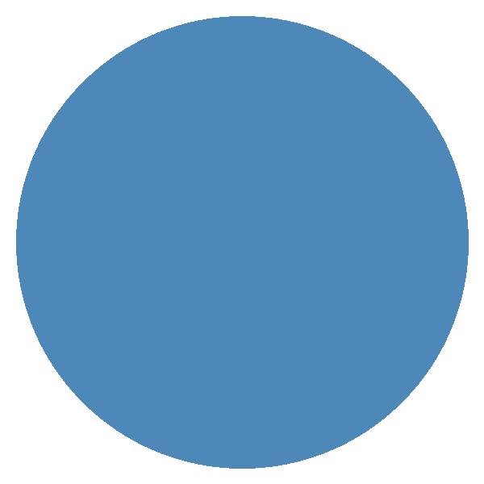
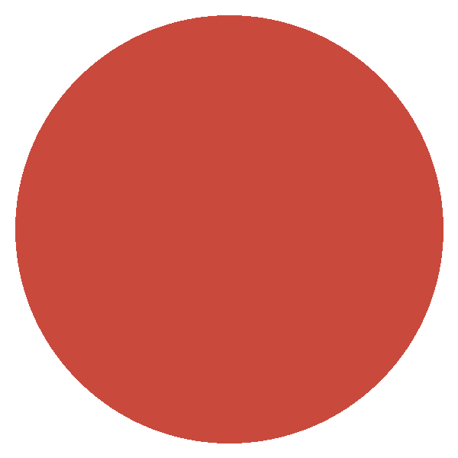
Pre-MAP Goal
Find the conditions where tides turn an uninhabitable planet into a habitable one
Project A
Project B
POISE only, cold start
POISE + EQTIDE, cold start
map the climates without tides
start frozen $→$ add EqTide
tides, billions of years
?
snowball
polar caps
ice free
runaway
snowball
temperate
No tides: each planet keeps its orbit and spin fixed
Thousands of runs across tilts and orbits, each sorted by where its ice ends up
Each planet starts as a snowball (POISE cold start)
EQTIDE slows the spin and tips the axis over billions of years while POISE follows the climate
Notes:
The goal is to find the conditions where tides make a planet habitable, and there are two parts to it. Student 1 runs POISE coupled to EQTIDE with a cold start: every planet begins as a snowball, and we let the tides change its spin and tilt for billions of years to see if the ice ever melts. Student 2 runs POISE alone, with no tides, and maps which tilts and orbits give a frozen planet, polar caps, an ice-free planet or a runaway greenhouse. Those maps tell Student 1 where to look, and Student 1 tells us whether tides can actually get a planet there.

